Slide 1
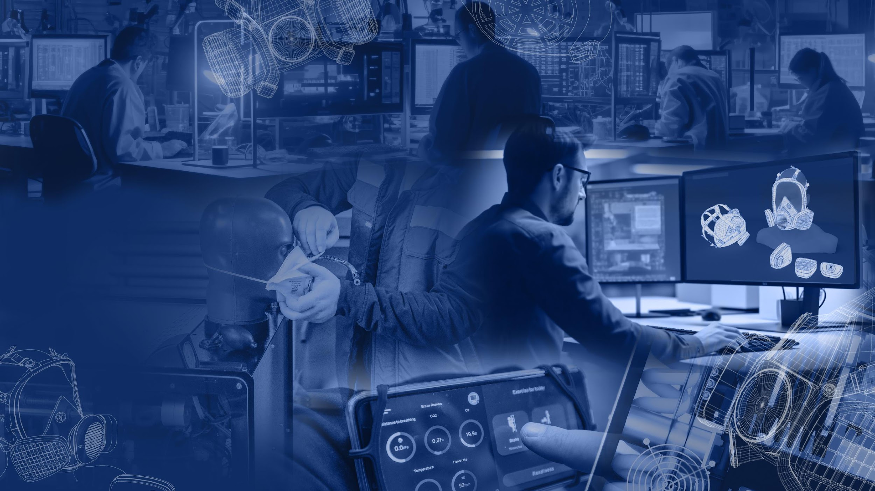

FASTER
MORE FLEXIBLE
EASIER
Measuring
people’s
safety
TEST EQUIPMENT
FOR THE RESPIRATORY
PROTECTIVE DEVICES

Slide 2



About company
SECOND BREATH OÜ is a research and manufacturing company based in Estonia whose subject of activity is innovative lab equipment and software for testing and quality control of all types of RPE, monitoring the physiological parameters of human breathing.
Our products are recommended for:
RPE
developers
and manufacturers
FILTERING
DEVICES
CERTIFICATION
bodies and
testing laboratories
BREATHING APPARATUSES
RESEARCH
centers
and universities
LIFE SUPPORT SYSTEM
MINING
industry
Since 2024 we are members of the International Society for Respiratory Protection (ISRP)

Slide 3
About company
5+
YEARS
of experience in own production of test equipment for RPE
13 SERIAL
TEST
EQUIPMENT
25+
YEARS
in the product line
of experience of the
company's employees
in RPE research
and development
20+
EMPLOYEES
in our team including engineers,
designers, programmers,
brand manager, customer service
and sales managers
70%
OF EXPERTS
have a scientific
degree
in engineering
and IT
6 NEW PRODUCTS
planned for release in 2024

Slide 4
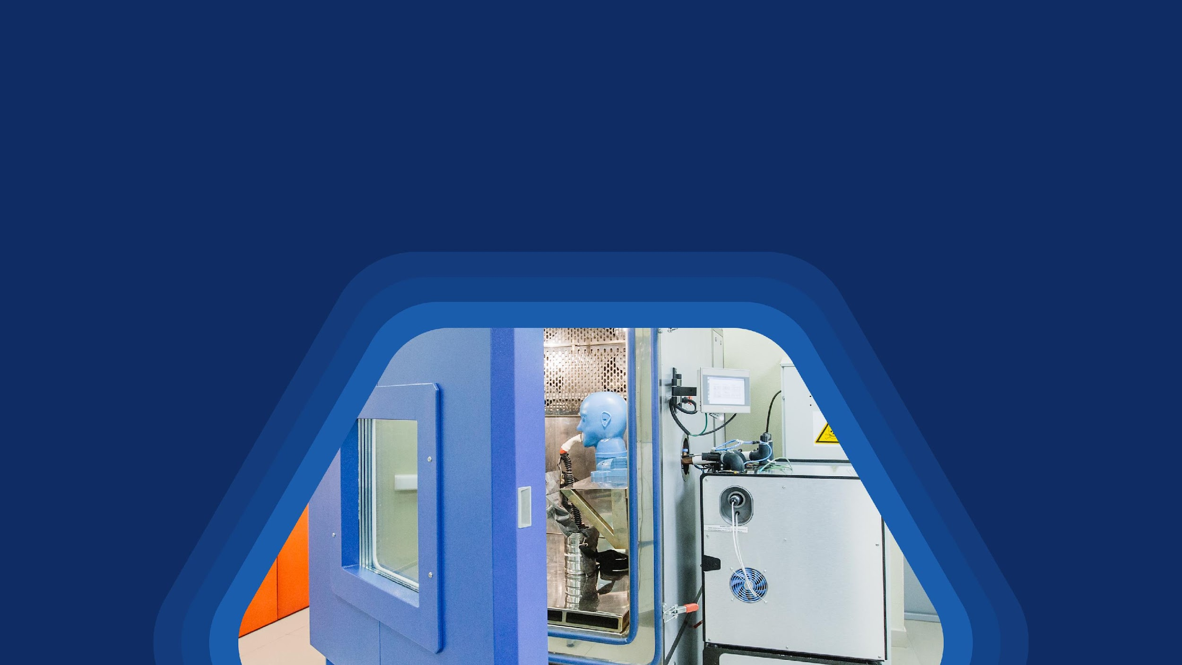
How we manufacture test equipment
Market,
customer
requests
analysis
R&D
work
Components selection from the world's best manufacturers
Own unique hardware and software parts development
Testing and internal quality control
Certification
and obtaining
a patent
for innovative technologies
Market
launch and
direct sales

Slide 5
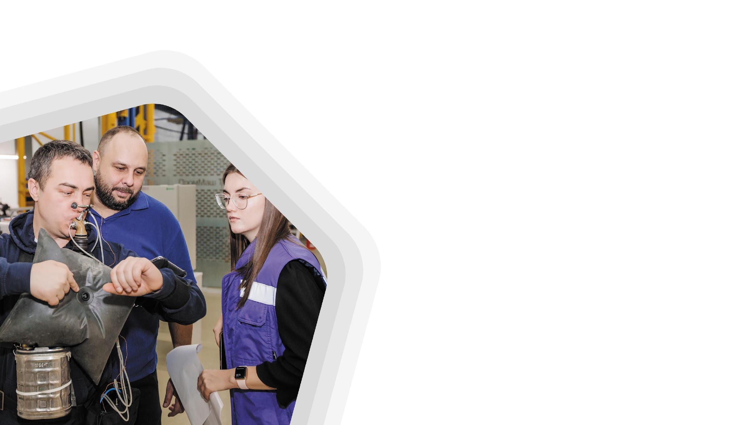
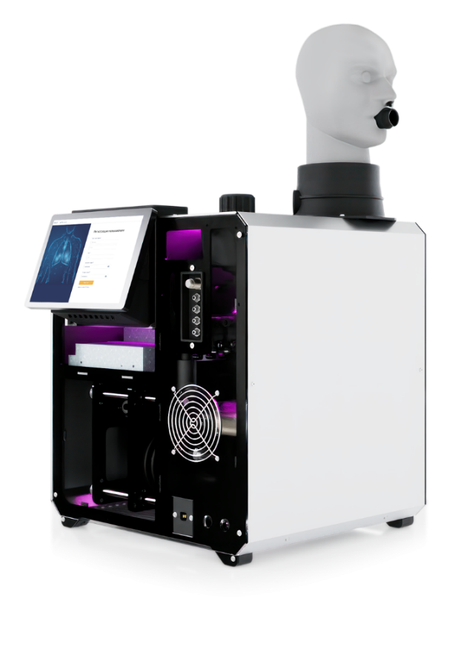
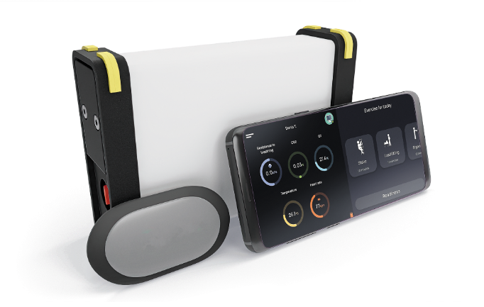
SECOND BREATH OÜ and mining industry
20+
YEARS
Metabolic breathing simulator OXY ROBOT
Mobile
breath recorder
our main engineer has experience in research and development SCSR
● for testing SCSR
● for incoming and
periodic inspection
● for annual
monitoring
SCSR program
for testing SCSR with volunteer person
is the first equipment
we produced
is unique device which has no analog in the world
Recommended for:
● developers and manufacturers SCSRs
● mining companies and mine rescue teams
● scientific and technology research and control organization and lab

Slide 6
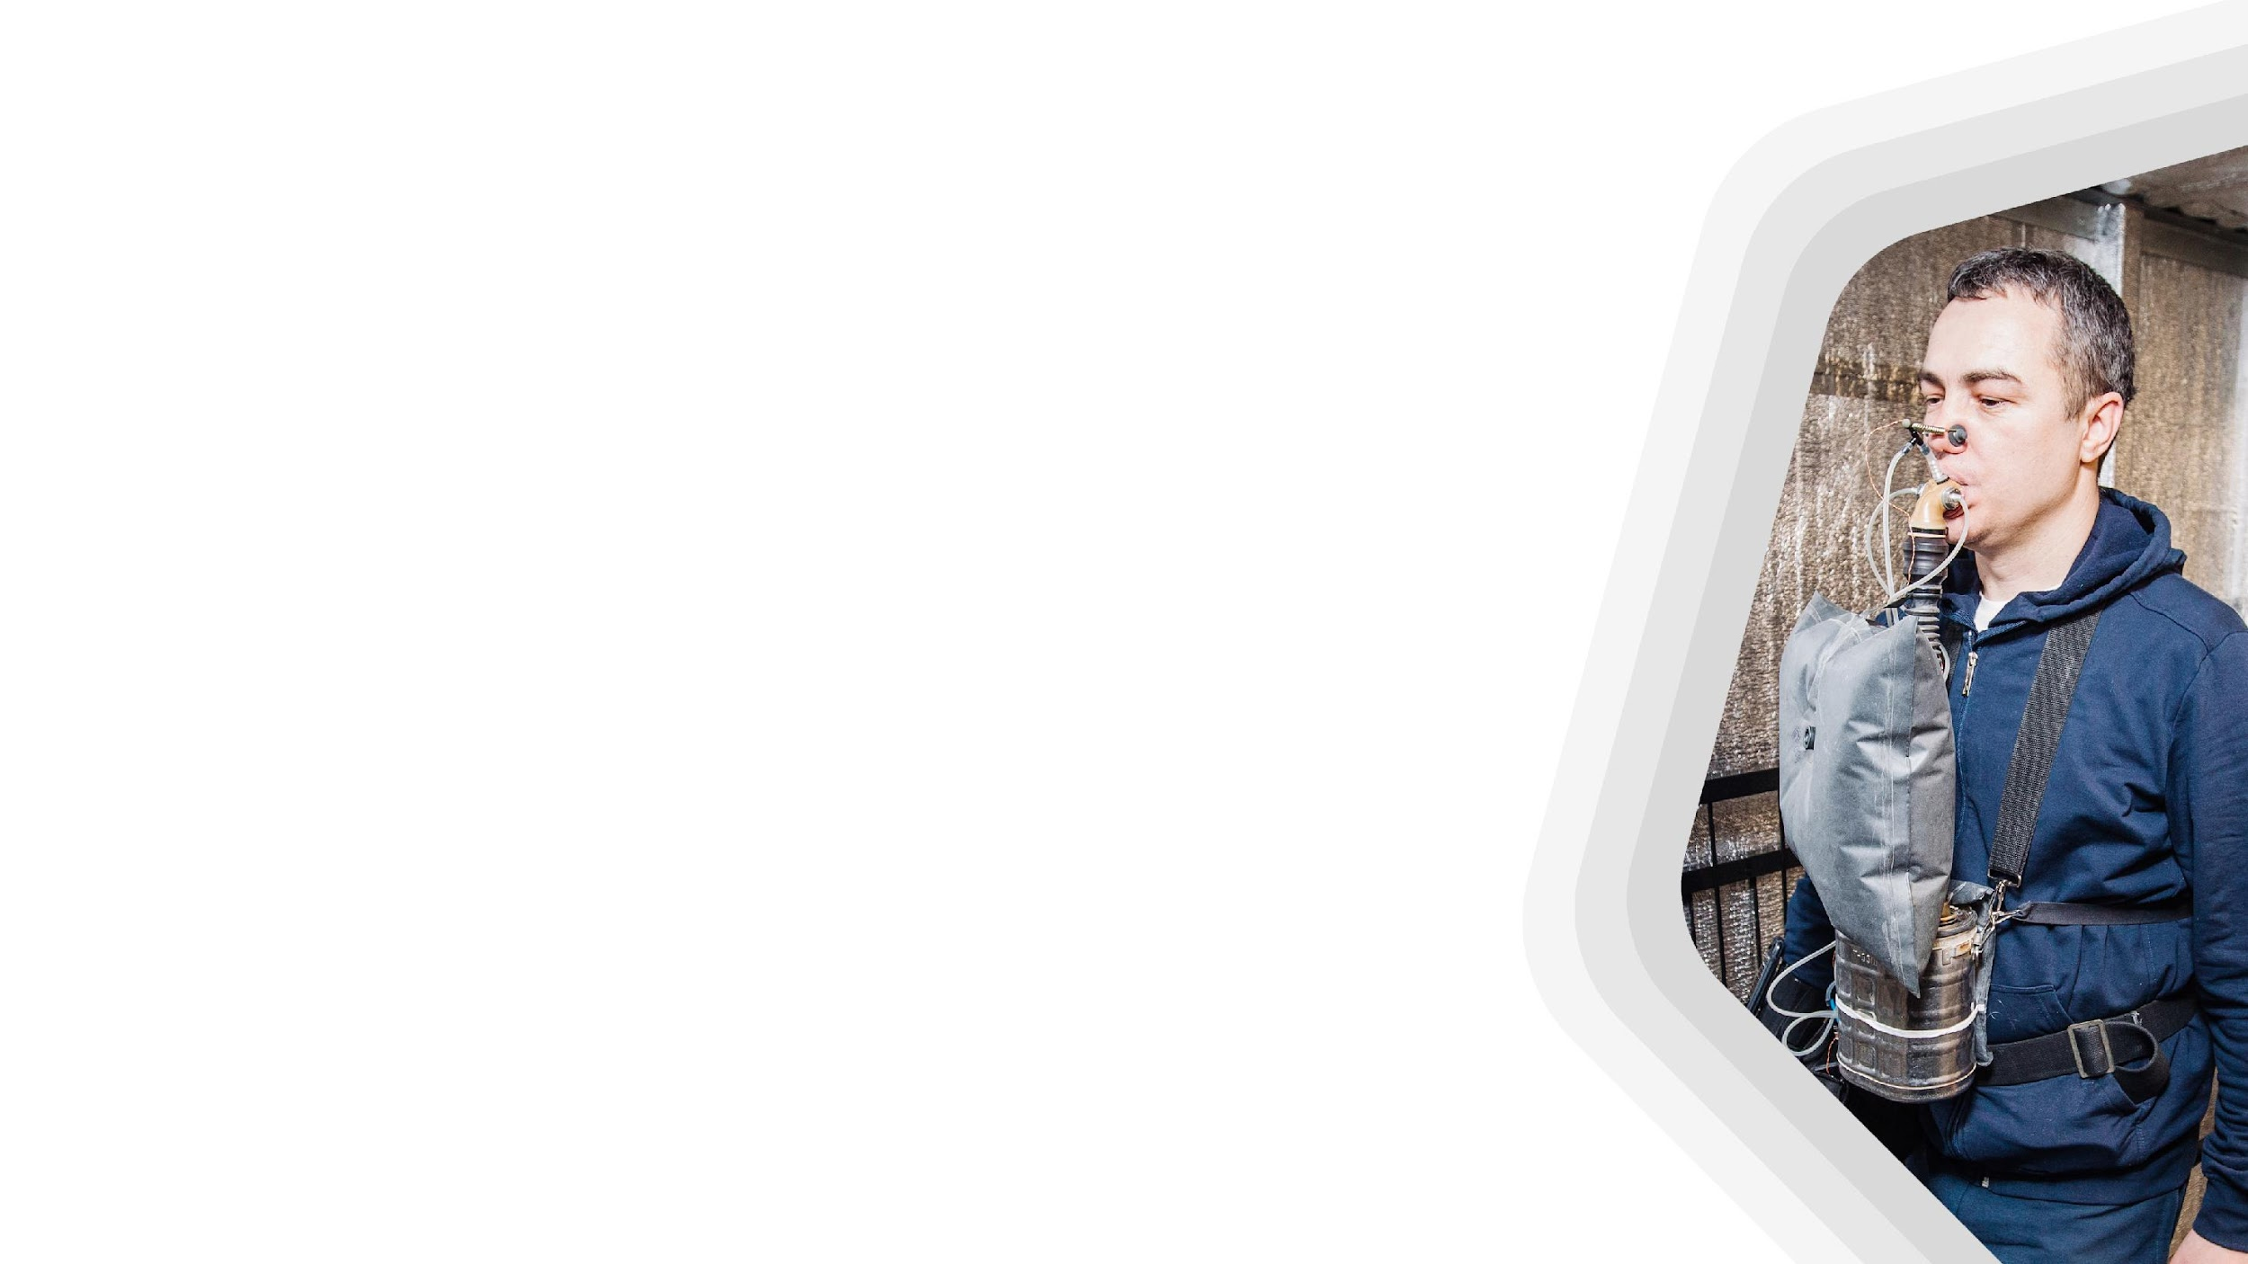

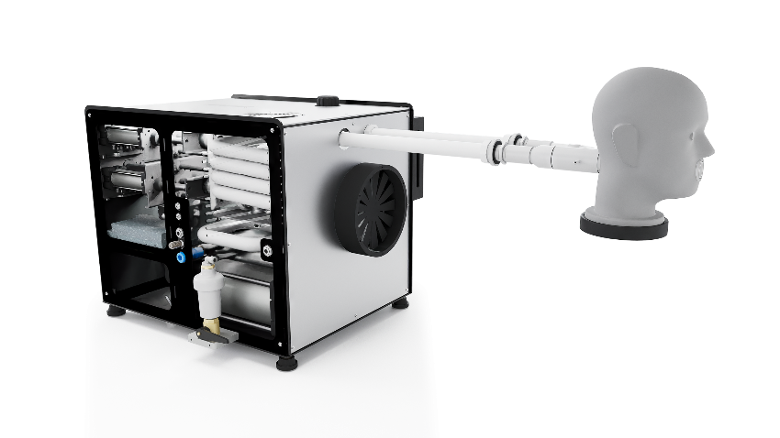

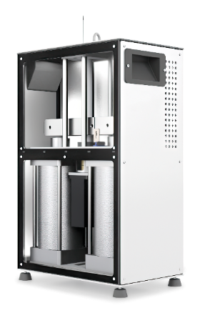
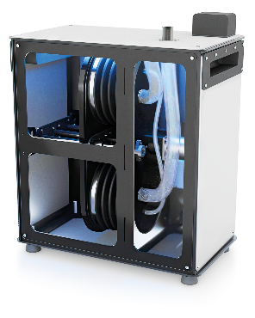
Test equipment for breathing apparatuses and life support systems
OXY ROBOT
metabolic
breathing
simulator
OXY ROBOT
pressure breathing simulator
MOBILE BREATH RECORDER
PULSAR
breathing machine
OLYMPUS
pressure breathing machine

Slide 7
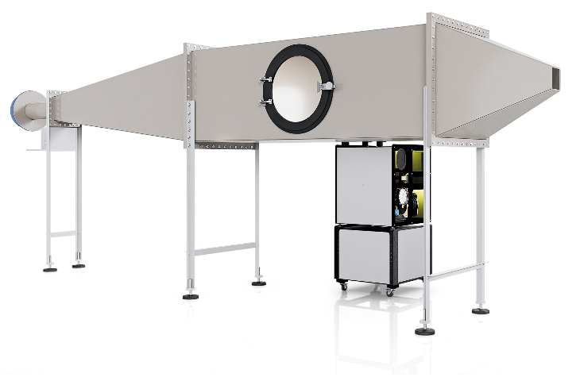
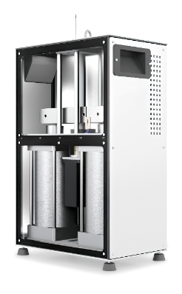
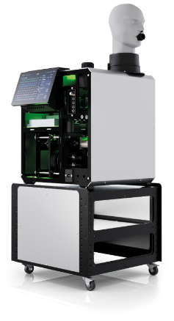
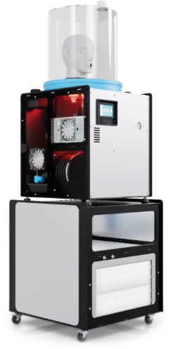
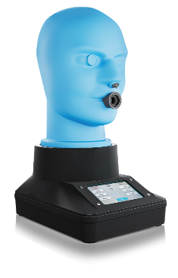
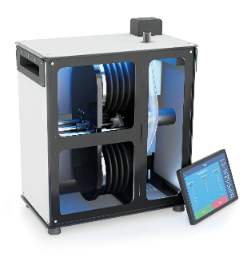
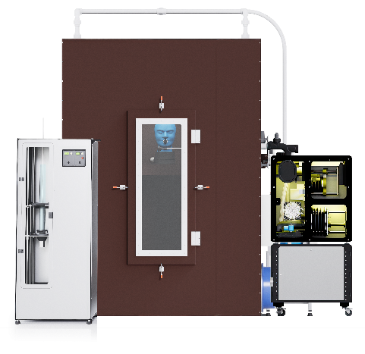
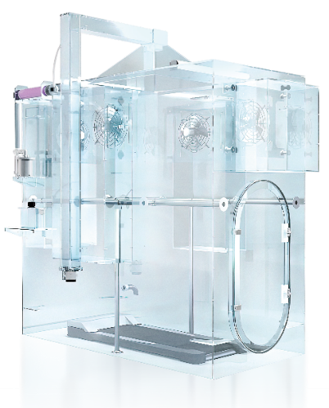
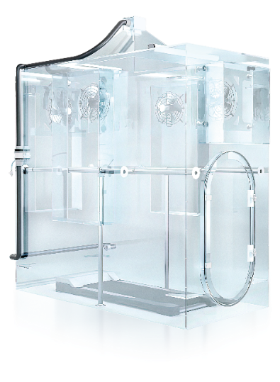
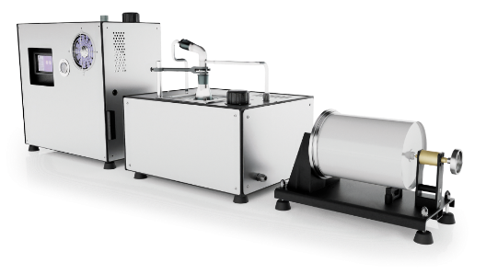
Test equipment for filtering devices
BOREAS
PULSAR
OLYMPUS
DIOXIDE
MONOXIDE
DOLOMITE
measuring
breathing resistance
breathing machine
pressure breathing
machine
measuring CO₂
content in the
«dead space»
measuring CO
content in inhaled air
measuring filters resistance
to dolomite dust clogging
SILICA DUST
DYNAMICS
SALT MIST
ELEGAS
measuring filters resistance
to silica dust clogging
evaluation of gas, vapor and
combined filters capacity
measuring total inward leakage (TIL)
with using NaCl aerosol
measuring total inward leakage (TIL)
with using SF₆

Slide 8
SECOND BREATH OÜ test equipment features:
WE
WE
WE
WE
● test equipment comes
to working mode fast
● test equipment have a high level of process automation and do not require constant staff involvement
● test parameters can be flexibly changed* in the test equipment software via an application
on a personal computer
* within technical possibilities
● test equipment have
a simple and convenient
interface to control
● test equipment have
lightened design
It’s FASTER
It’s MORE FLEXIBLE
It’s EASIER
It has ERGONOMIC
DESIGN
YOU
YOU
YOU
YOU
● can carry out more tests per day
● increase your productivity
● do other important work task at the same time
● not have to change all or part of the test equipment if industrial standards are updated or new one release, or if you carry out research tests
● get minimum manual switching
● can quickly and easily master the control of the test equipment and involve even a laboratory intern in the work
● get attractive laboratory
and additional inspiration
to design RPE

Slide 9
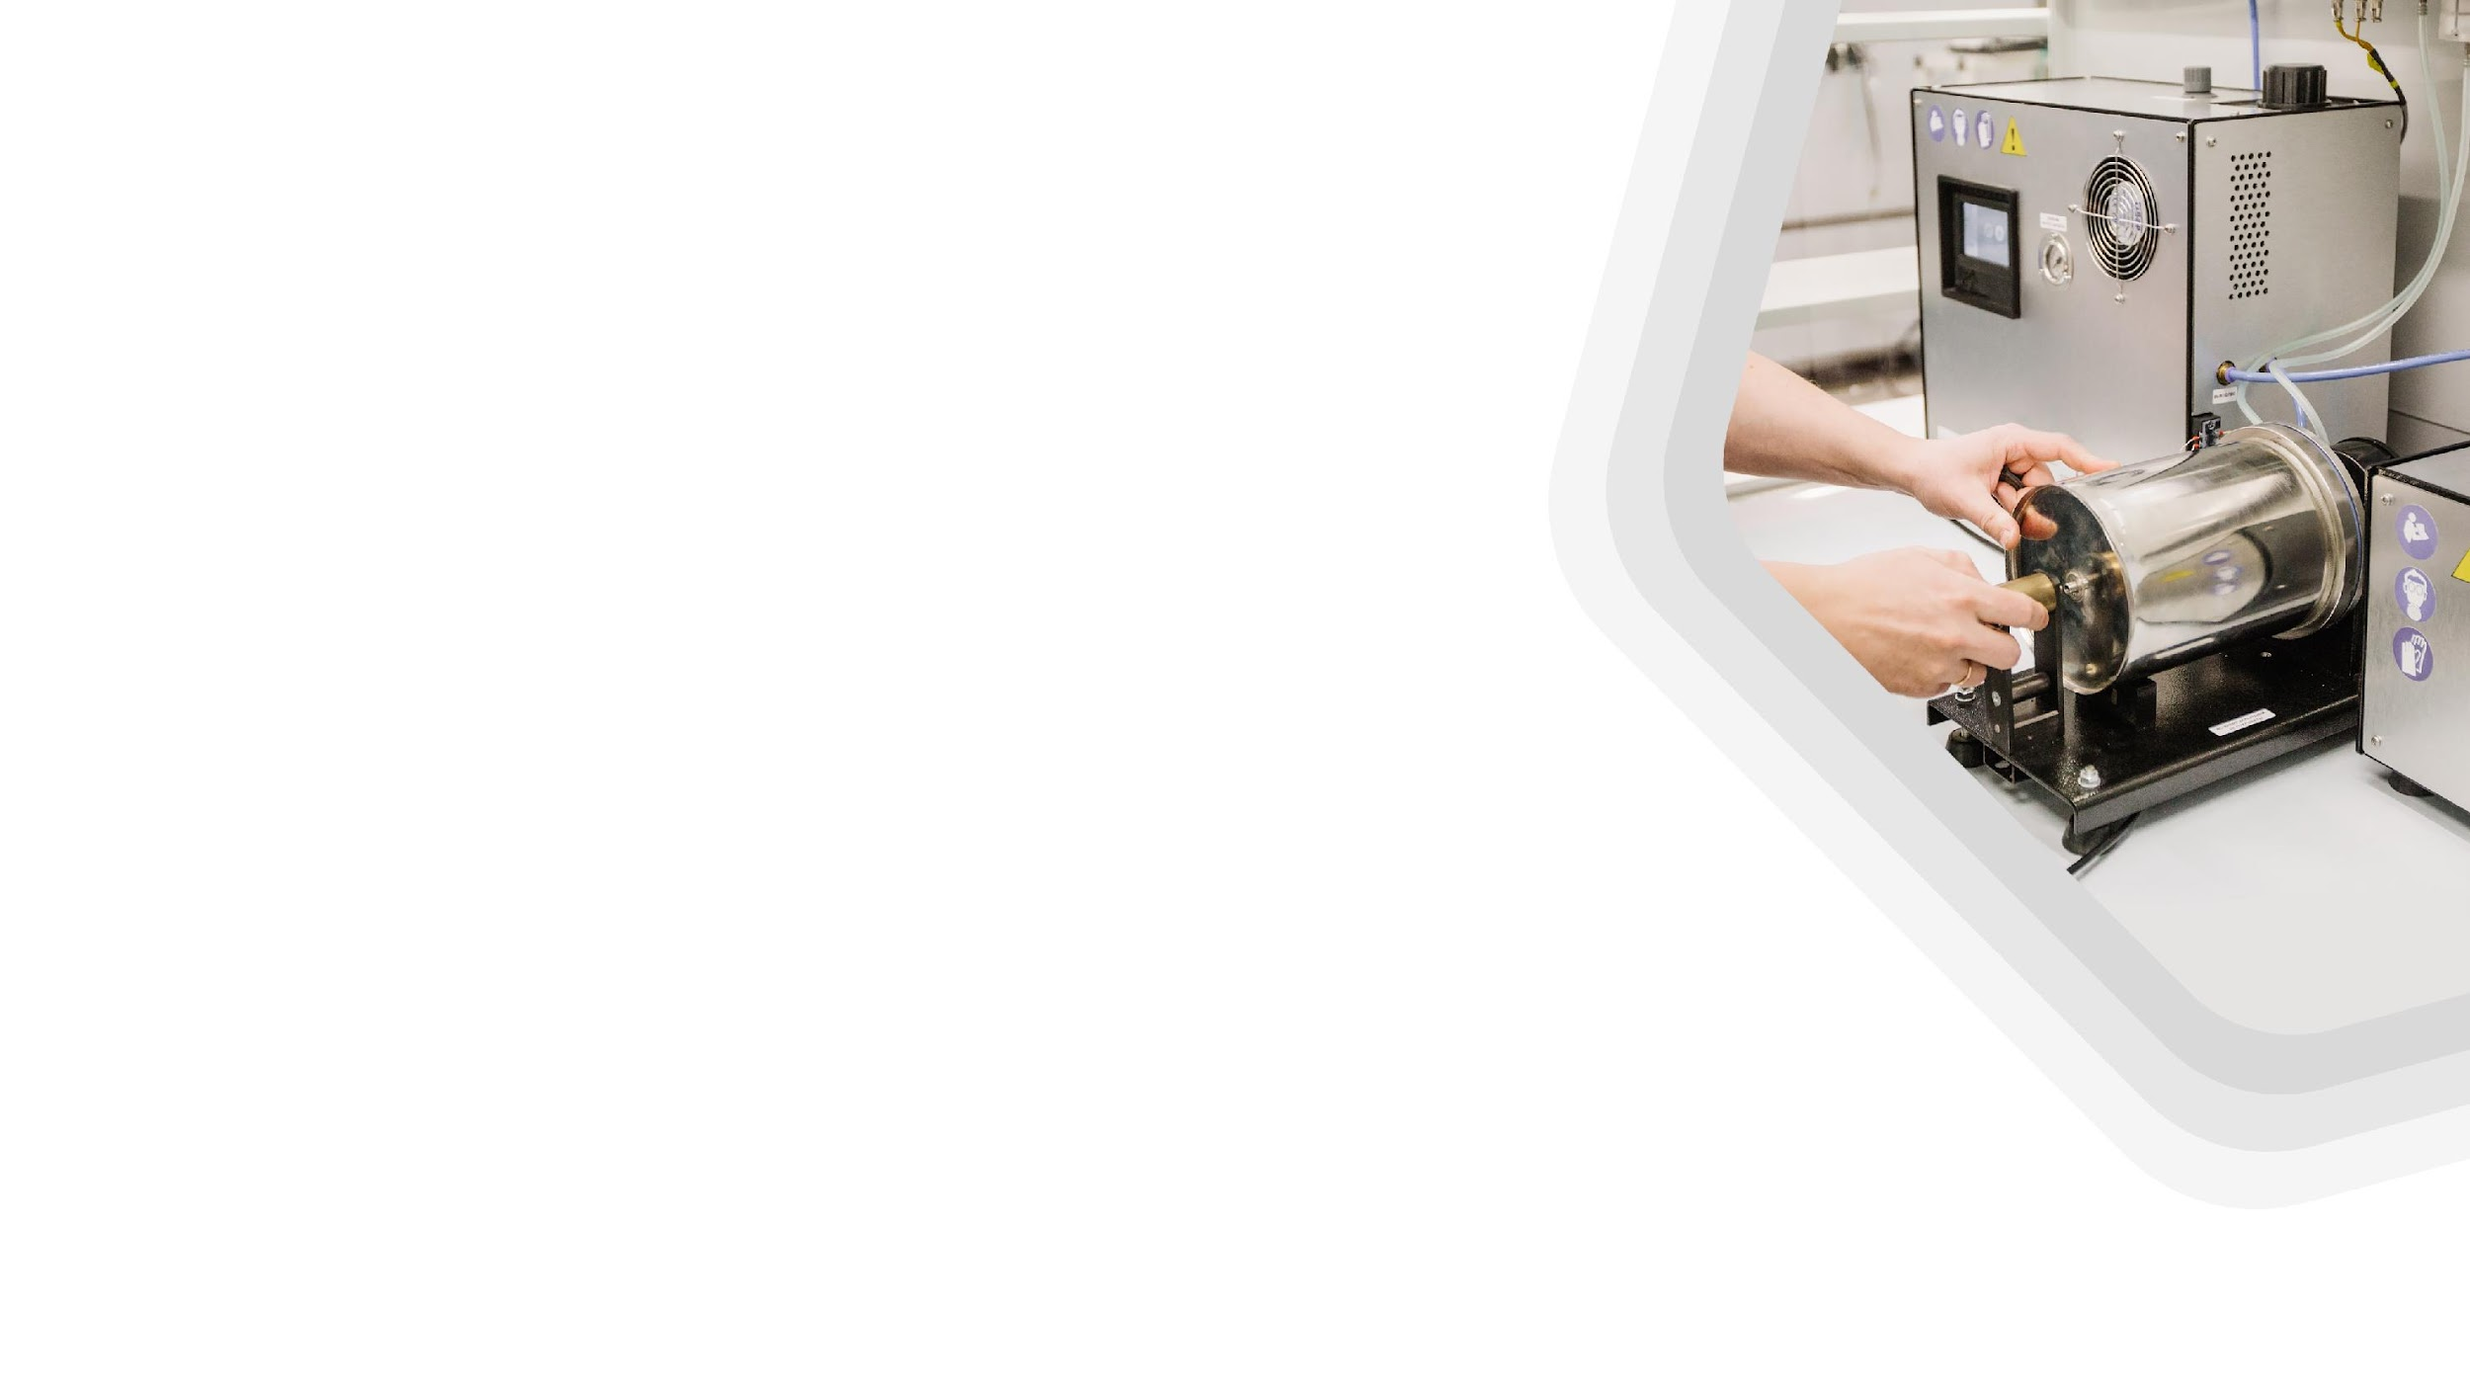
About service
Warranty from
12 month
Training of the customer’s staff
Personal service
manager
Service support for
the entire period of use
Development of equipment according to your terms of reference

Slide 10

Below you will take a closer look at our equipment,
but first, remember a few icons that will help you to navigate
for testing breathing apparatuses
for testing filtering devices
work in a climate chamber
work in conditions
of low and high atmospheric pressure
testing with volunteer person

Slide 11

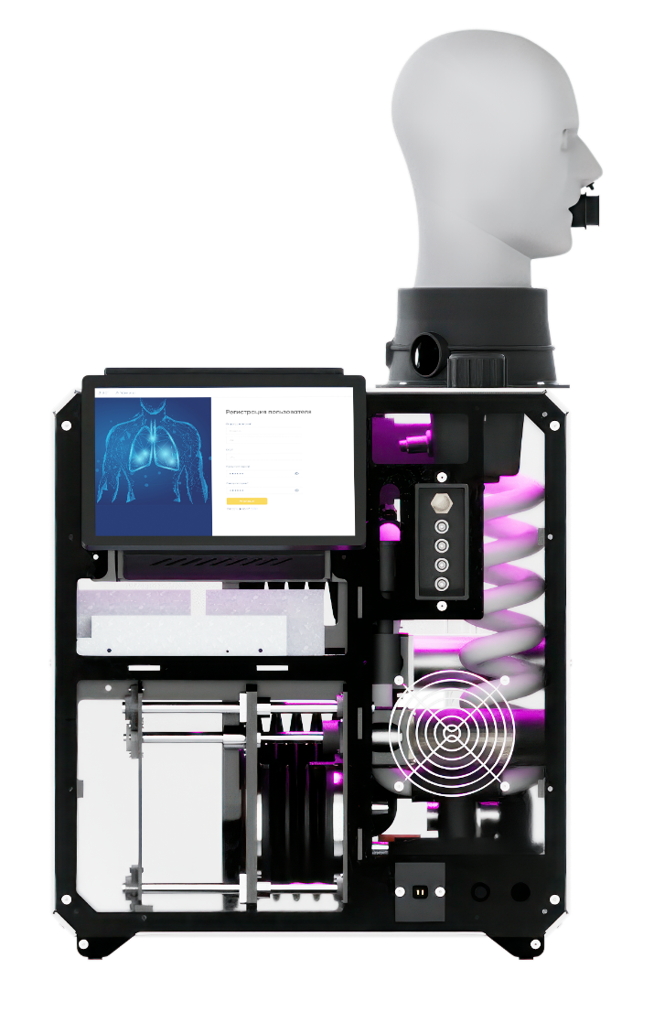
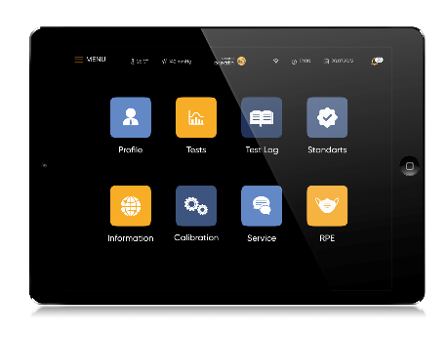


Human breathing simulation
Flagship product
OXY ROBOT
metabolic breathing simulator
recreate human inhale and exhale with necessary humidity and temperature, the exchange of gasses: O₂ consumption, CO₂ release; reproduce breathing according to prerecorded breathing curve of a real person at different loads.
Can be completed with a pumped or heated dummy human head or tee.
OXY ROBOT
pressure breathing simulator
APPLICATION:
SCBA, Airline BA, SCSR on chemically bonded or compressed oxygen, EBA, life support systems, closed- and semi-closed circuit rebreather, (CCR, SCR), open-circuit SCUBA
suitable for tests in conditions of high atmospheric pressure (up to 6 atm).). Design with cylinders
RELEVANT STANDARDS*:
ISO 16900-5:2016(E), EN 401, EN 14143 and others*
Controlled
via touch-screen display
Watch clip
If you interest in this products, send your request on info@second-breath.ee to get the datasheet
Notes:
Oxy Robot

Slide 12

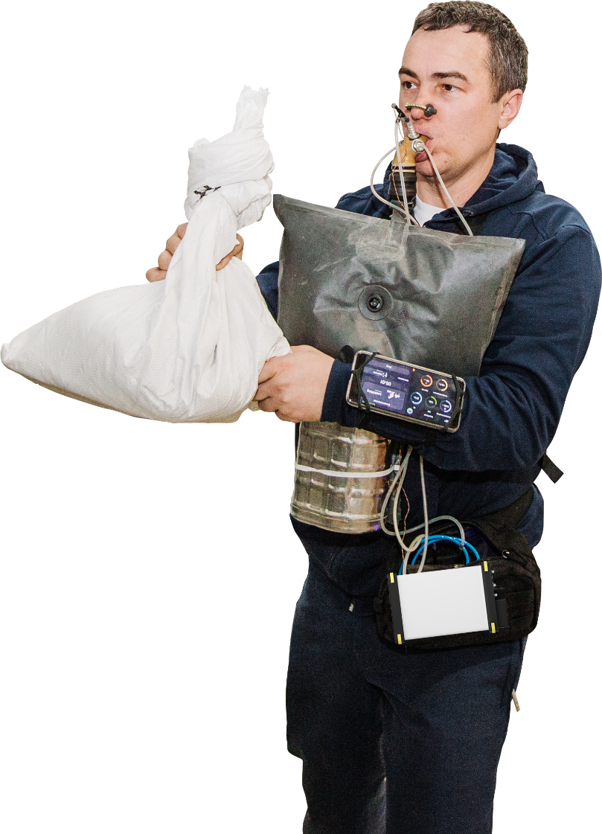

Testing breathing apparatuses with persons
MOBILE BREATH RECORDER test equipment
a portable wireless device and software that is connected to a real RPE and records the parameters
of a person's breathing
in it under various loads
and climatic conditions
(up -40 to 40 C°).
the load during testing process.
You can create an exercise program
for testing and find out the breathing parameters
at the time of these loads from the report.
smartphone
and application
for choosing
the loads
and getting
feedback
about own
breathing
Complements the testing program conducted
with Metabolic breathing simulator OXY ROBOT
volunteer
person
tested breathing
apparatus
MEASUREMENT PARAMETERS:
Breathing
resistance
CO₂
O₂
Inhale
temperature
Heart
rate
portable measuring unit —
unique system connects
with RPE and record breathing parameters
Watch clip
If you interest in this products, send your request on info@second-breath.ee to get the datasheet
Notes:
Oxy Robot

Slide 13
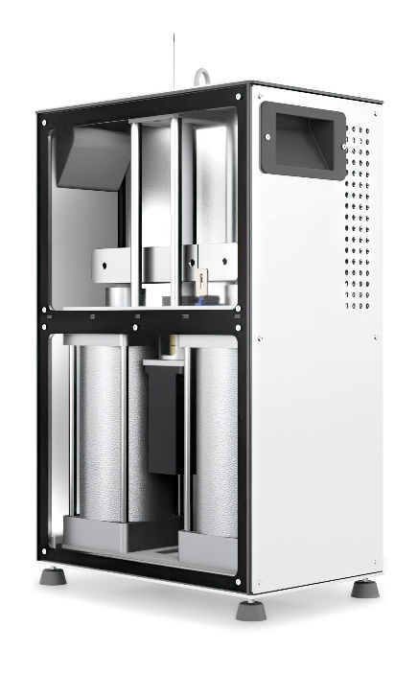
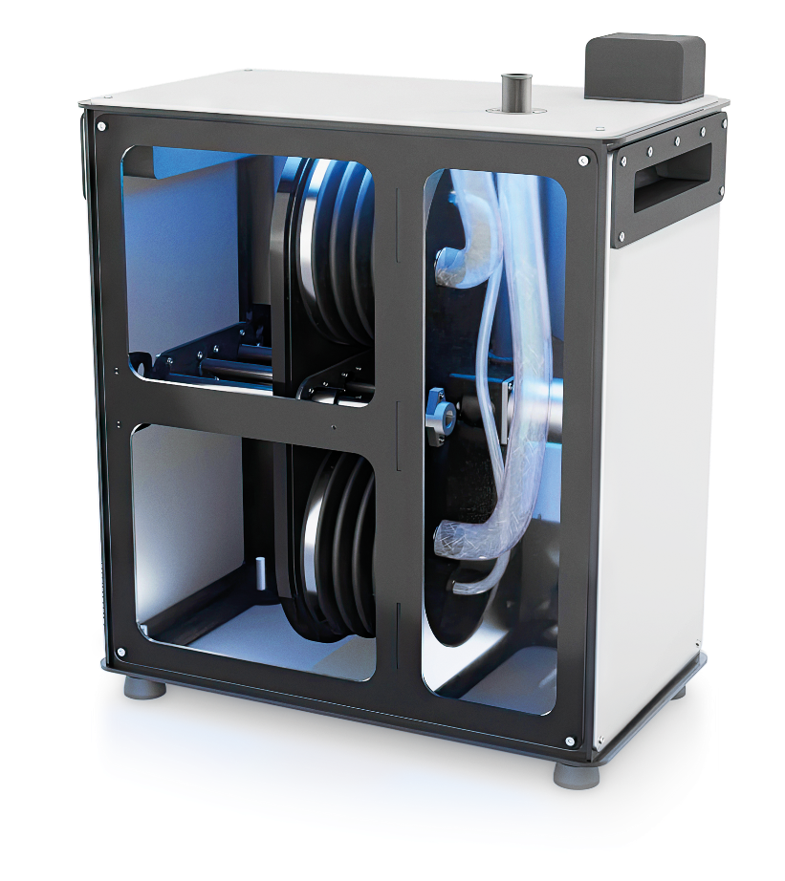
Lung ventilation simulation
Artificial lungs
PULSAR
breathing machine
OLYMPUS
pressure breathing machine
create a pulsating air flow that imitates human breathing with the required value of lung ventilation. Can be completed with a pumped or heated dummy human head.
Controlled via Bluetooth-chanel
suitable for tests at normal atmospheric pressure. Design with bellow pumps. Controlled via Android app
suitable for tests in conditions of ambient pressure difference. Design with cylinders
If you interest in this products, send your request on info@second-breath.ee to get the datasheet
Notes:
Oxy Robot

Slide 14

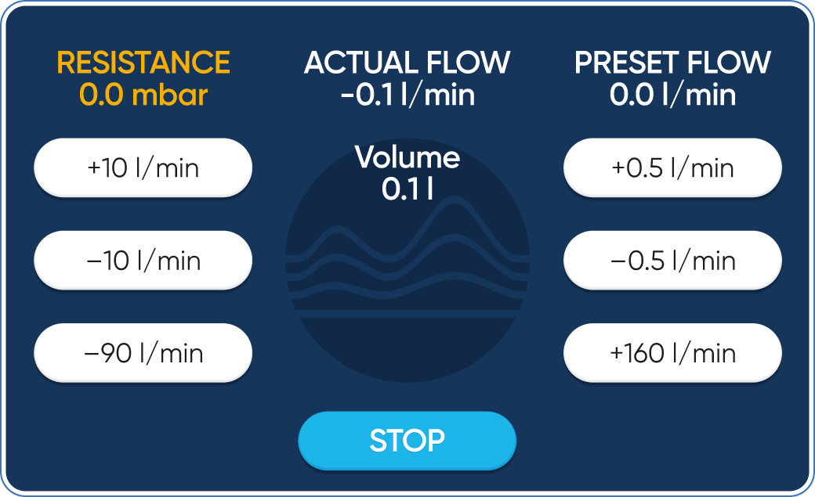


Measuring breathing resistance
Test device BOREAS
Controlled
via touch-screen display
creates a constant air flow through the RPE in the directions of «exhalation» and «inhalation» and measures the air pressure difference between the surrounding atmosphere and the mask space of the RPE, calculates the resistance to air flow.
APPLICATION:
RPE with full-face and half-mask; anti-aerosol, anti-gas and combined RPE with an insulating front part; filtering self-rescuer; RPE from radioactive substances.
RELEVANT STANDARDS*:
EN 136, EN 140, EN 143, EN 149, EN 405, EN 1827
and others...
Watch clip
If you interest in this products, send your request on info@second-breath.ee to get the datasheet
Notes:
Oxy Robot

Slide 15
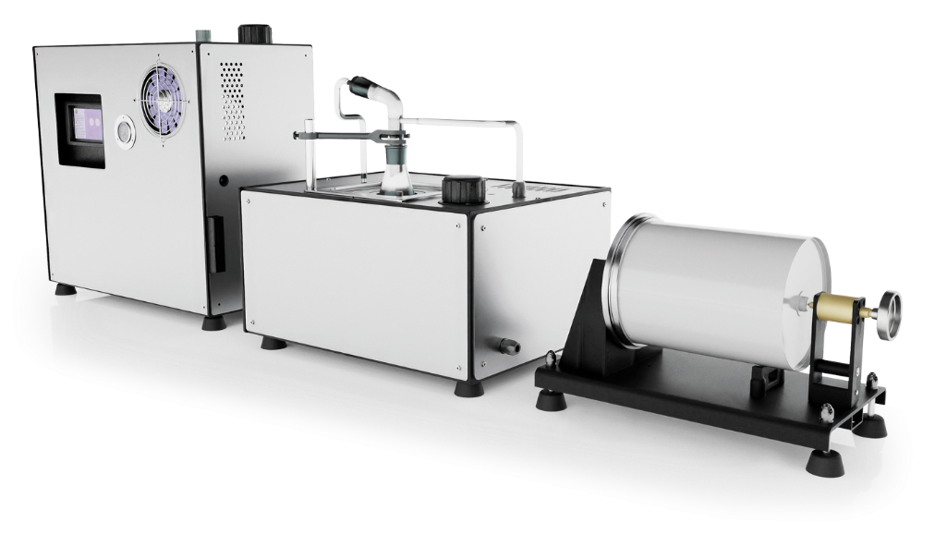
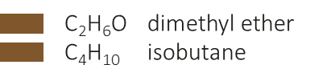

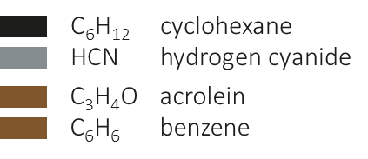
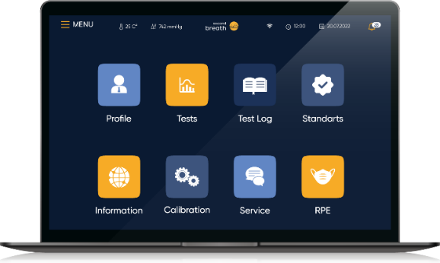
Evaluation of filters capacity using test agents
Test equipment DYNAMICS
Test different types of filters on the same test equipment. Configuration options for one test equipment design:
1) Dynamics G: up 2 to 7* test gases:
Cl₂ chlorine
SO₂ sulfur dioxide
H₂S hydrogen sulfide
NH₂ ammonia
NO nitric oxide
2) Dynamics G2: 2* gases:
* the number of test agents in one test
equipment is determined individually
HCl hydrogen chloride
AsH₃ arsenic hydrogen
3) Dynamics V: up 1 to 4* vapors
Watch clip
prepares the gas-vapor-air mixture in accordance with the conditions for using the tested filter - the required temperature, relative humidity, concentration of the test agents and passes this mixture through the filter until the test agent is detected in the air sample at the outlet of the filter (breakthrough concentration) or until the filter protection time, which is set by the RPE manufacturer, expires.
4) Dynamics Hg
APPLICATION:
gas, vapor and combined filters
RELEVANT STANDARDS*:
EN 136, EN 140, EN 143, EN 149, EN 405, EN 1827
and others...
Hg hydrargyrum
Controlled via personal computer (laptop)
If you interest in this products, send your request on info@second-breath.ee to get the datasheet
Notes:
Oxy Robot

Slide 16



Measuring CO₂ and CO content in inhaled air
developed on OXY ROBOT breathing simulator hardware and software platform
DIOXIDE test equipment
creates a pulsating air flow that imitates human breathing with the necessary parameters of breathing frequency and depth and volume concentration of CO₂ on «exhalation» and measures CO₂ content in a mask “dead space”.
creates a pulsating air flow that imitates human breathing with necessary parameters of breathing frequency and depth, temperature and relative humidity, creates a test atmosphere with necessary conditions — temperature, moisture content, volume of carbon monoxide (CO) and measures CO content that has passed through the filter of tested RPE in the required time.
MONOXIDE test equipment
Controlled via
touch-screen display
APPLICATION:
full-face masks, half-masks, quarter-face masks, masks with helmet or hood
APPLICATION:
filtering self-rescuers
RELEVANT STANDARDS*:
EN 1827, EN 12941,
EN 136, EN 149, EN 403, EN 404, EN 405
and others...
RELEVANT STANDARDS*:
EN 403, EN 404
and others...
Watch clip
Watch clip
If you interest in this products, send your request on info@second-breath.ee to get the datasheet
Notes:
Oxy Robot

Slide 17


Measuring dust clogging resistance
developed on OXY ROBOT breathing simulator hardware and software platform
DOLOMITE test equipment
acc. to EN standards
test equipment creates a special dust atmosphere and constant air flow in the test chamber for the tested respirator and the breathing machine simulates human breathing with necessary parameters of lung ventilation, humidity and temperature of exhalation. As a result of the test respirator resistance to constant airflow after clogging is determined. This time is compared with requirements of industry standards.
SILICA DUST test equipment
acc. to NIOSH standard
Using test agent is dolomite dust
Using test agent is silica dust
APPLICATION:
respirators with anti aerosol
and combined filters
Controlled via personal computer (laptop)
APPLICATION:
HEPA filters designed for powered air-purifying respirators (PAPRs)
RELEVANT STANDARDS*:
EN 149, EN 143, EN 13274-8, EN 405,
EN 1827, EN 12941, EN 12942, EN 14387
and others...
RELEVANT STANDARDS:
procedure № RCT-APR-STR-0025 NIOSH
Watch clip
Watch clip
If you interest in this products, send your request on info@second-breath.ee to get the datasheet
Notes:
Oxy Robot

Slide 18
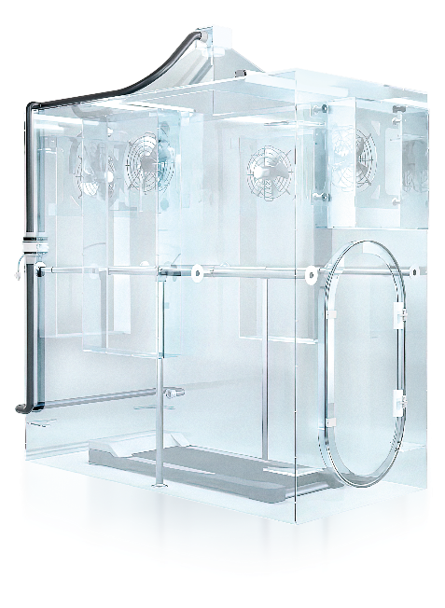

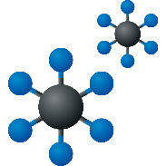
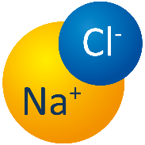


Measuring total inward leakage (TIL)
test RPE with persons
ELEGAS test equipment
test equipment creates a special atmosphere with a test agent and determines the leakage of it under a mask bypassing a filter when a volunteer person is doing exercises in the tested RPE on the treadmill into the test chamber.
SALT MIST test equipment
APPLICATION:
full face & half masks with aerosol filter, half masks with valves and non-removable gas or combined filter, filtering self-rescuers
RELEVANT STANDARDS*:
EN 149, EN 13274-8, EN 136,
EN 1827, EN 12941, EN 12942
and others...
Using test agent
is sulfur hexafluoride (SF6)
Using test agent
is sodium chloride aerosol (NaCl)
Watch clip
Controlled via personal computer
Watch clip
If you interest in this products, send your request on info@second-breath.ee to get the datasheet

Slide 19
How quickly SECOND BREATH OÜ
test equipment reach* operating mode
Instantly
no more
10 min
no more
15 min
no more
20 min
no more
40 min
no more
60 min
PULSAR,
OLYMPUS,
BOREAS,
MOBILE
BREATH
RECORDER
DIOXIDE
OXY ROBOT
DYNAMICS GAS,
ELEGAS,
SALT MIST
MONOXIDE
DYNAMICS VAPOR,
DYNAMICS HYDRARGYRUM,
DOLOMITE,
SILICA DUST
* Time to reach the operating mode is the time interval after power supply is applied to the equipment, after which the specified technical characteristics required for testing must be achieved.

Slide 20
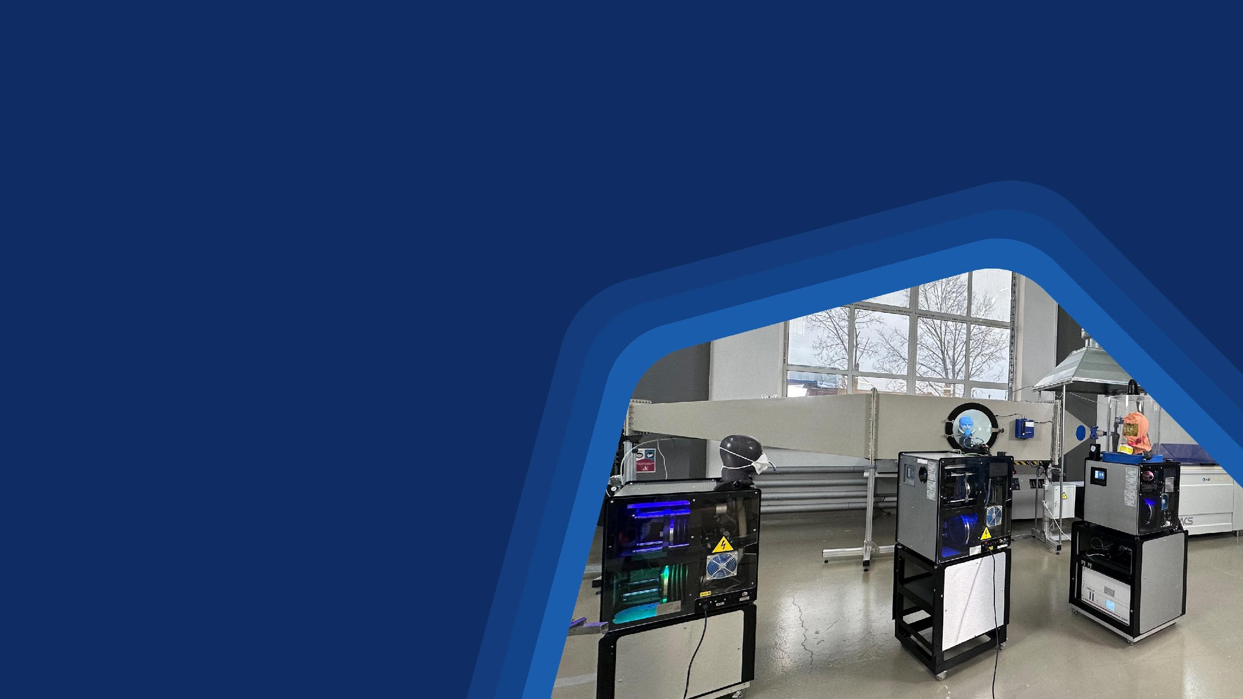

Measuring
people’s
safety
Address: Valge 13, 11415, Tallinn, Estonia
Phone & business WA: +37 269 807 09
E-mail: info@second-breath.ee
Web: www.second-breath.ee
STAY IN THE LOOP!
Linkedin: Second Breath OÜ
Youtube: @secondbreath5264
VIDEO PRESENTATION

